Slide 1


Enhance the Security of Extended Playfair Cipher using Extended RSA for Secure Data Transmission
Institute of Engineering & Technology
SESSION : 2022 – 23
Team Members :
Ayush Sharma
Yashraj Singh
Piyush Kumar Singh
Hemant Gautam
Supervised By :
Dr.Neeraj Varshney
Assistant Professor & Assistant Director -IQAC
(Institute of Engineering & Technology)

Slide 2

CONTENT
ABSTRACT
INTRODUCTION
- Introduction about Playfair Technique
- Limitations of Playfair 5×5 Matrix
- Overcome The Problem Of PlayFair 5×5 Matrix by PlayFair 16X16 Matrix
- Introduction about Extended RSA algorithm
PROPOSED MODEL
PROPOSED ALGORITHM
SOURCE CODE OVERVIEW
FUTURE SCOPE
CONCLUSION

Slide 3
ABSTRACT
In today’s digital world cryptography is used to secure information in order to provide the privacy for the intended sender and receiver by managing the message with the public key.
The objective of this work is to securing the key of Playfair cipher using Extended RSA algorithm.
The existing methods of Playfair cipher modified by increasing in the size of matrix, so We will use 16X16 Matrix for pick cipher characters. It makes use of alphabets both lower and uppercase characters, number and special characters for constructing the contents of the matrix.
Enhance the security of Extended Playfair cipher using 16X16 matrix by implementing the Extended RSA Algorithm in the 16X16 Playfair. which will use the asymmetric key. Which is based on public and private key encryption technique . it use two different keys to encrypt and decrypt the message.
The idea of RSA Algorithm is it takes only two prime number P and Q while In Extended RSA here we can take multiple prime number for Encrypt the Playfair key which will make it more secure than the RSA Algorithm. Finally, the security strength of the whole system has been analyzed and tried to fulfil the requirement of security.

Slide 4
INTRODUCTION
The word cryptography comes from the Greek origin. It is a combination of two words Crypto and Graphy. Crypto means Secret and Graphy means Writing . Cryptography deals with creating documents that can be shared secretly over public communication channels. The present Scenario, everyone needs to encrypt the message at the sender side and decrypt it at the receiver side to preserve security and privacy. So cryptography is the study of creating and using encryption and decryption techniques. In cryptography the term plaintext is used for the original message that is to be transformed. The message which has been transformed is called Ciphertext. An encryption algorithm works with a key to transform the plaintext into ciphertext. Decryption algorithm works in the reverse order and converts the ciphertext into plaintext. The encryption /decryption algorithm is to encrypt/decrypt the message with the help of a key. The process of converting plaintext into ciphertext is called enciphering or encryption. The process of retaining the plaintext from the ciphertext is called deciphering or decryption. The following figure shows the encryption and decryption process.

Slide 5
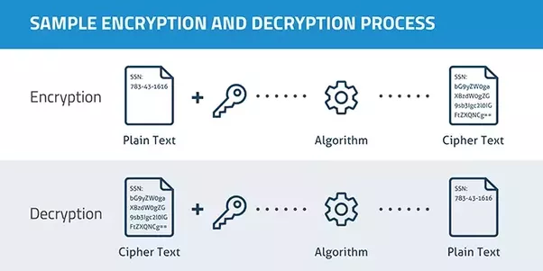
Fig 1. The following figure shows the Simple encryption and decryption process.

Slide 6
Introduction about Playfair Technique
The Playfair cipher was the first practical digraph substitution cipher. The scheme was invented in 1854 by Charles Wheatstone but was named after Lord Playfair who promoted the use of the cipher. In playfair cipher unlike traditional cipher we encrypt a pair of alphabets(digraphs) instead of a single alphabet. Playfair is reasonably fast to use and requires no special equipment.
The Algorithm consists of 2 steps:
1. Generate the key Square(5×5):-
• The key square is a 5×5 grid of alphabets that acts as the key for encrypting the plaintext. Each of the 25 alphabets must be unique and one letter of the alphabet (usually J) is omitted from the table (as the table can hold only 25 alphabets). If the plaintext contains J, then it is replaced by I.
• The initial alphabets in the key square are the unique alphabets of the key in the order in which they appear followed by the remaining letters of the alphabet in order.

Slide 7

2. Algorithm to encrypt the plain text:
The plaintext is split into pairs of two letters (digraphs).
Example:- Key : Monarchy
Plain Text : “Instruments”
After Split : ‘in’ ‘st’ ‘ru’ ‘me’ ‘nt’ ‘sz’
THEN --
With The Help Of key Square Grid and Plain Text pair We Gets The Cipher Text
Of The Plain Text.

Slide 8
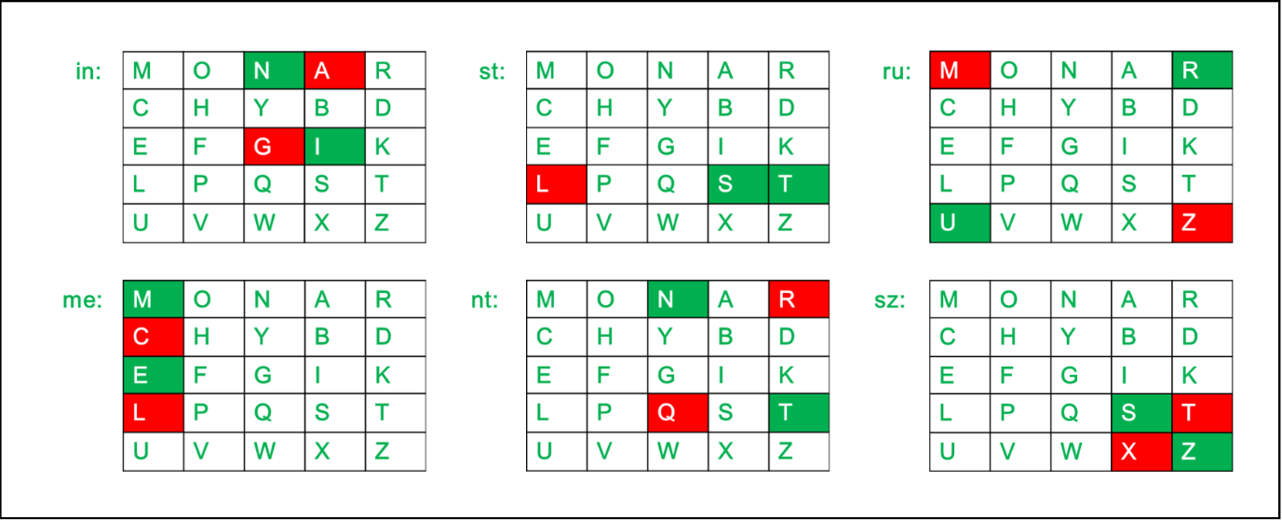
Plain Text : “Instruments”
Cipher Text : “gatlmzclrqtx”
Limitations of Playfair 5×5 Matrix
1: Only Upper Case Letters Can Be Encrypt No Lower Case Letters Can Be Encrypted.
2: one letter of the alphabet (usually J) is omitted from the table (as the table can hold only 25 Alphabets).
3: Symbols can’t be encrypted.
Example :- if we want to encrypt email ID "yash@gmail.com"
Here, “@” and “.” Remain Unencrypted. Which makes it less secure.

Slide 9
Overcome The Problem Of PlayFair 5×5 Matrix by PlayFair 16X16 Matrix
To Overcome The Disadvantages Of PlayFair 5×5 Matrix The Extension of Playfair Cipher using 16X16 Matrix was Introduced.
THE PROPOSED PLAYFAIR CIPHER USING 16X16 MATRIX
This algorithm can accept the Plaintext containing Alphabets (capital letters and small letters), Numbers and Special characters. So the user can easily encrypt combination of alphabets, numbers and characters efficiently.
Algorithm Of PlayFair 16X16 Matrix :
Read a keyword.
Eliminate the repeated characters in keyword.
Construct a matrix by filling the character of keyword from left to right and top to bottom.
Fill the reminder of matrix with the remaining characters from ASCII values 0 to 255.
Read a plaintext.
Divide the plaintext into pair of characters.
Add the character “Null” when odd number of character in the message.

Slide 10
The following example uses of Playfair 16x16 Matrix
Key | Playfair - (Sample)
Plaintext as a single word : Ciphertext : | Cryptography :feuq])yeZ
Plaintext as a phrase : Ciphertext : | American Online Service ?e).p\lo↗Uü⇞lt⇐m).up\)⇗
Plaintext as a sentence : Ciphertext : | Hardwork has a future pay off, Laziness Pays off now. Gye]xqPu3~fo¶⇏vuå⇕⇐ey§sa(&↓Umoltf|~⇏eyfq¶~iy‼~qx(⇗
Plaintext as a Email Id : Ciphertext : | m.ilayaraja_2012@gmail.com p(rayfy.⇗Y(Y3123Bcpyrap^za

Slide 11
PlayFair 16X16 Matrix
P | l | a | y | f | i | r | . | ( | S | m | p | e | ) | NUL | ⇗
⇘ | ⇞ | ⇟ | ⇝ | ⇜ | • | ⇕ | ⇔ | ⇖ | ⇛ | ⇚ | ⇠ | ⇡ | ⇙ | ⇑ | ⇓
↕ | ‼ | ¶ | § | ⇏ | ↖ | ↑ | ↓ | → | ← | ↗ | ↔ | ⇐ | ⇒ | Space | !
“ | # | $ | % | & | „ | * | + | , | - | / | 0 | 1 | 2 | 3 | 4
5 | 6 | 7 | 8 | 9 | : | ; | < | = | > | ? | @ | A | B | C | D
E | F | G | H | I | J | K | L | M | N | O | Q | R | T | U | V
W | X | Y | Z | [ | \ | ] | ^ | _ | ` | b | c | d | g | h | j
k | n | o | q | s | t | u | v | w | x | z | { | | | } | ~ | DEL
Ç | ü | é | â | ä | À | å | ç | ê | ë | è | ï | î | ì | Ä | Å
É | æ | Æ | ô | ö | Ò | û | ù | ÿ | Ö | Ü | ¢ | £ | ¥ | ₧ | ƒ
á | í | ó | ú | ñ | Ñ | ª | º | ¿ | ↛ | ¬ | ½ | ¼ | ¡ | « | »
⇋ | ⇌ | ⇍ | ↟ | ↥ | ↺ | ↻ | ↯ | ↮ | ↼ | ↪ | ↰ | ↶ | ↵ | ↴ | ↡
↢ | ↧ | ↦ | ↤ | ↞ | ↨ | ↷ | ↸ | ↳ | ↭ | ⇂ | ↿ | ↹ | ↩ | ⇅ | ⇀
⇁ | ↽ | ↾ | ↲ | ↱ | ↫ | ↬ | ⇄ | ⇃ | ↣ | ↠ | ⇈ | ⇇ | ⇉ | ⇊ | ⇆
α | ß | Γ | π | Σ | Σ | µ | Τ | Φ | Θ | Ω | δ | ∞ | φ | ε | ↘
↙ | ± | ≥ | ≤ | ↜ | ↝ | ÷ | ≈ | ° | ∙ | · | √ | ⁿ | ² | ⇎

Slide 12

List of Advantages :-
It considers the space between two words in plaintext as one character.
The user can easily encrypt and decrypt the combination of alphabets, numbers and special characters efficiently.
Letters, digits and special characters are used to construct 16x16 matrix.
It is case sensitive.
The letters I and J are considered as two different letters.
This algorithm cannot separate a repeating Plaintext letters with a filter letter.
It allows more than 36 characters as keyword.

Slide 13
Introduction about Extended RSA Algorithm
RSA is a cryptographic algorithm used in secure communications. RSA is designed to ensure that two parties can agree on a secret Message without the need for a third party to help. RSA is often used in secure communications such as financial transactions and passwords.
The extended Euclidean algorithm is a security algorithm that is used in the RSA Algorithm. The extended Euclidean algorithm is a modified algorithm that is used to improve the security of the RSA Algorithm. Extended Euclidean Algorithm is a cryptographic algorithm that was designed by the National Security Agency and The National Security Agency Institute of Electrical and Electronics Engineers. The Algorithm is used to create a secure digital signature. Extended RSA will also use the asymmetric key. Which is based on public and private key encryption technique. The idea of RSA Algorithm is it takes only two prime number P and Q while In Extended RSA here we can take multiple prime number for Encrypt the Playfair key which will make it more secure than the RSA Algorithm. The Extended Version of RSA Algorithm is Called Extended RSA. Finally, the security strength of the whole system has been analyzed and tried to fulfil the requirement of security.

Slide 14
Extended RSA Algorithm follow these steps:
Generate a public key and private key
a. Generate by deciding n prime number as 𝑝 , 𝑞 , r , s , t…..etc.
b. Multiple 𝑝, 𝑞, r, s, t……etc. to get the value of 𝑛
Cal n = p x q x r x s x t…..etc.
c. Find out the 𝜙𝑛 by using the (𝑝 − 1)(𝑞 − 1)(r-1)(s - 1)(t - 1)……etc. formula
d. Decide the value of 𝑒, while 𝑒 = 1 < 𝑒 < 𝜙𝑛, and must be coprime and the greatest common distribution of 𝜙𝑛
e. The value of 𝑑 can be calculated by the following formula 𝑒𝑑 (𝑚𝑜𝑑 𝜙𝑛 ) = 1
f. Results public key and private key value will be (𝑛, 𝑒) and (𝑛, 𝑑) respectively
2. Encrypt; encrypt the string with 𝑐 = 𝑚^𝑒 𝑚𝑜𝑑 𝑛 formula using the new generated key before
3. Send the cipher text c to recipient
4. Decrypt the cipher text in plain text m=c^d mod n

Slide 15

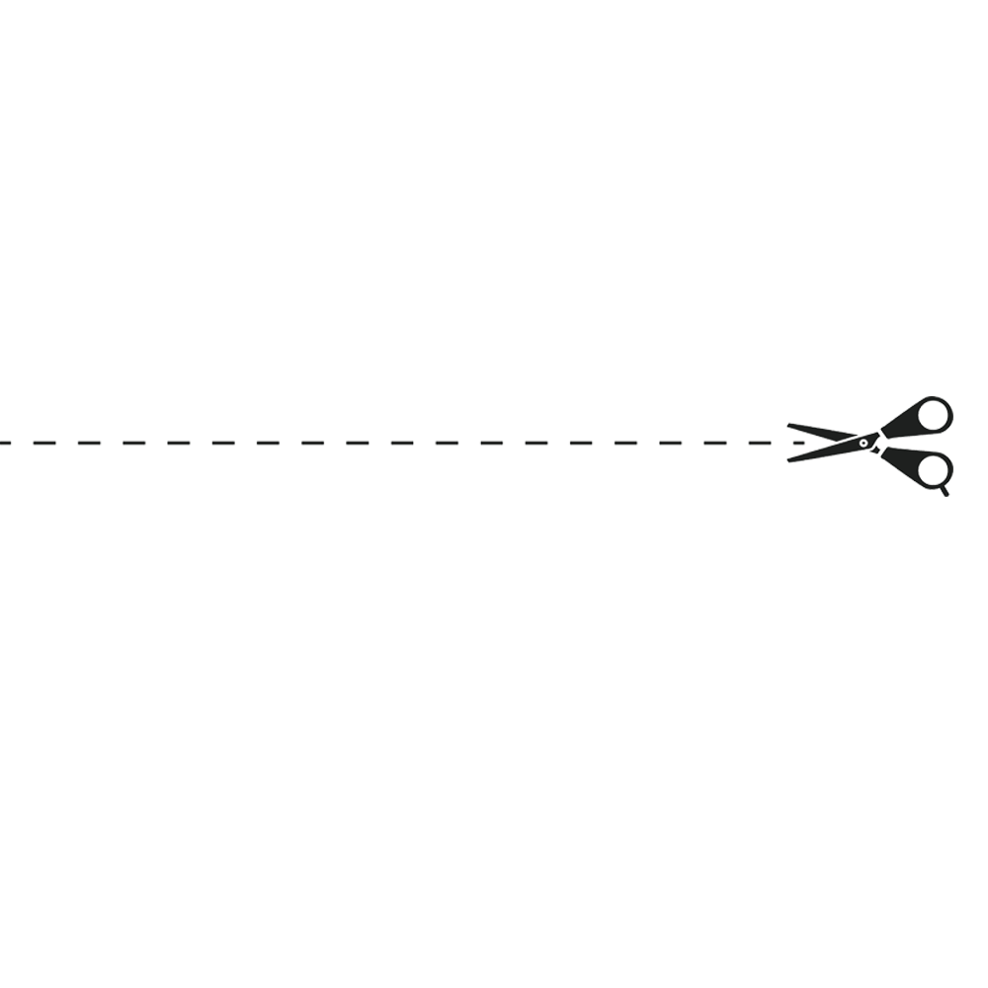

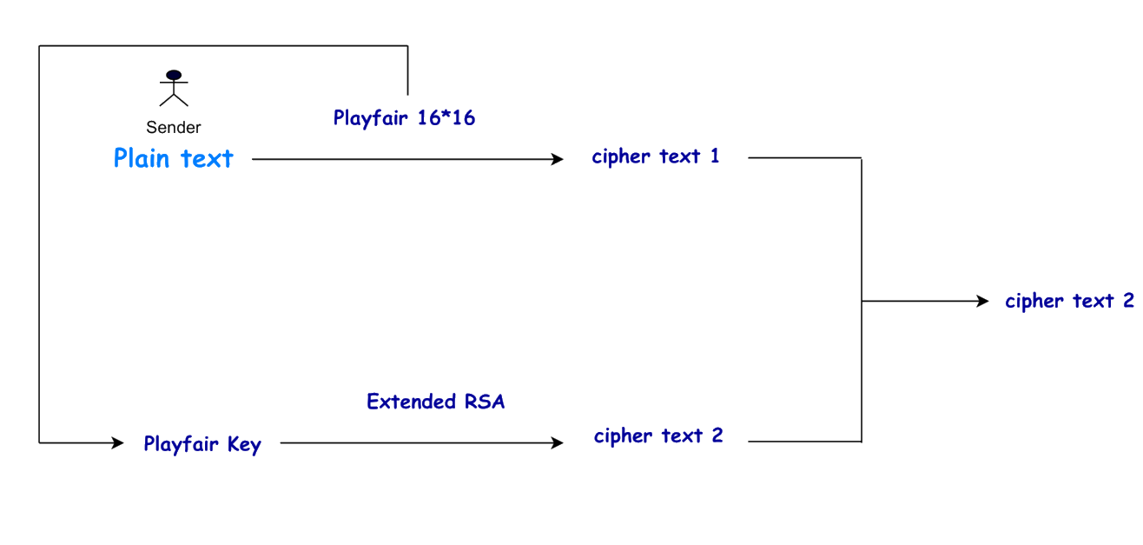
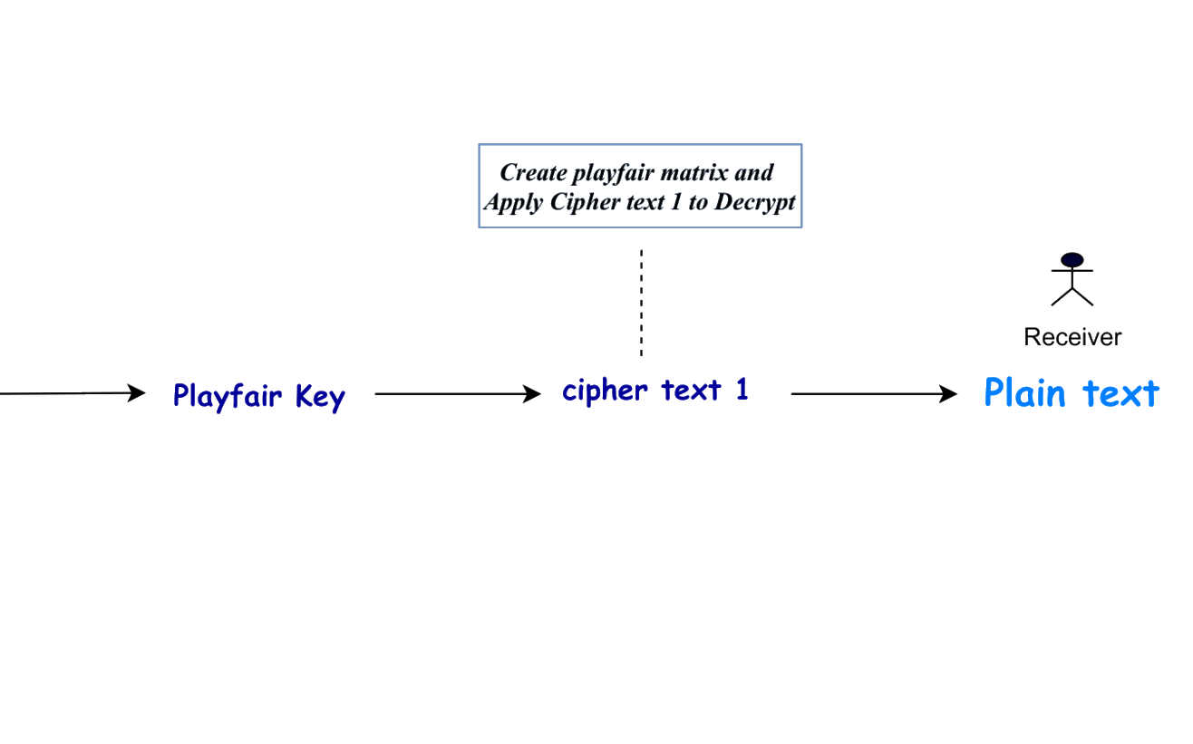
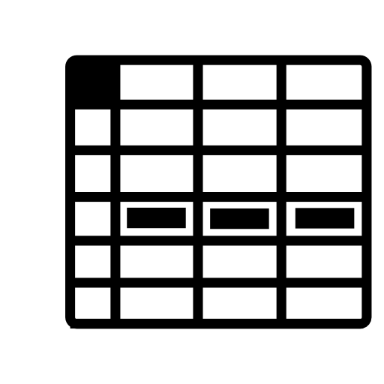





PROPOSED MODEL
Encryption
Decryption

Slide 16
Proposed Algorithm
Step 1 : - Sender will give a Plain Text and a Playfair Key .
Step 2 :- Plaintext is encrypted using Playfair 16X16 and converted to ciphertext 1 (see in above figure of Proposed Model)
Step 3 : - Playfair key is Encrypted using Extended RSA and converted to Cipher text 2(see in above figure of Proposed Model ) in order to make it more secure.
Step 4 : - Cipher text 2 (Ciphertext of key) is decrypted to get back the Playfair key.
Step 5 : - Create Playfair matrix using Playfair key and apply ciphertext 1 to decrypt .
Step 6 :- Cipher text 1 is Decrypted using Playfair Matrix and Plain text or message is visible at the Receiver side

Slide 17
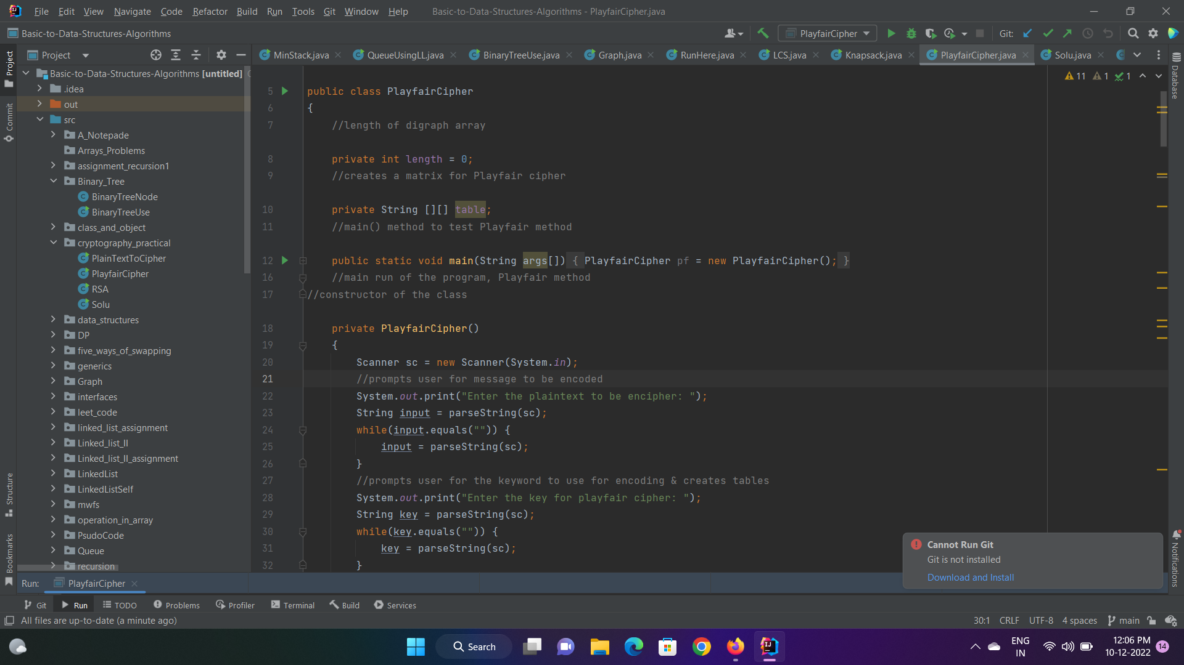
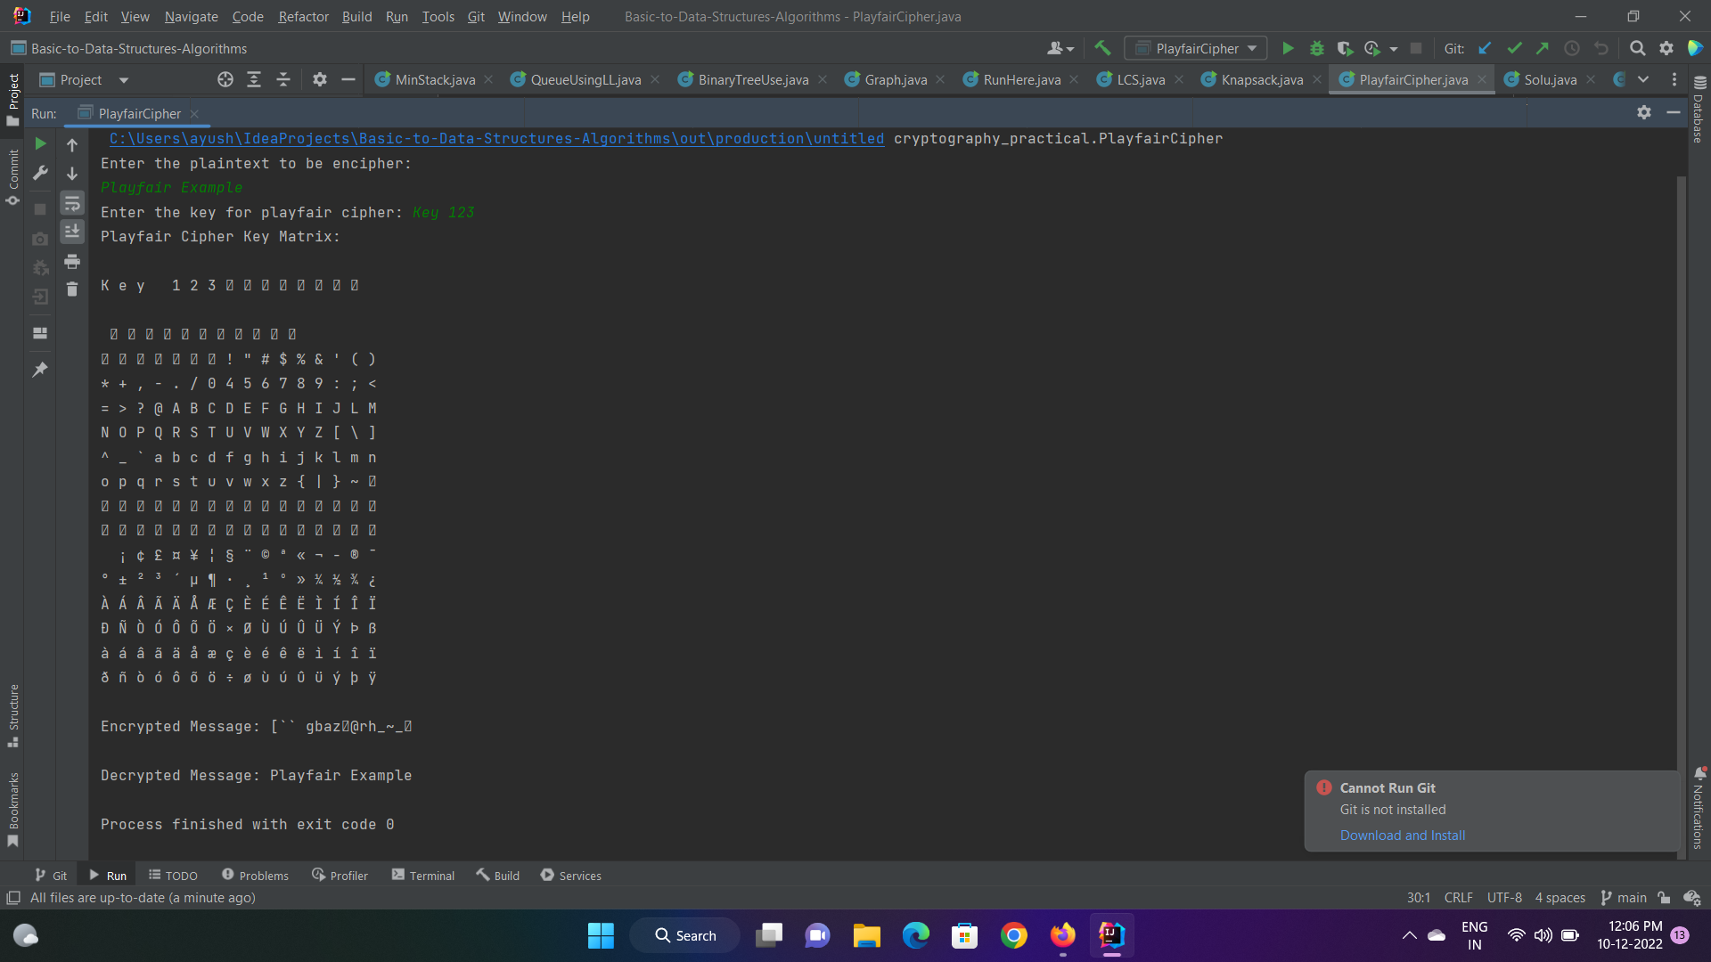
Source code Overview
Play Fir 16X16 :-

Slide 18
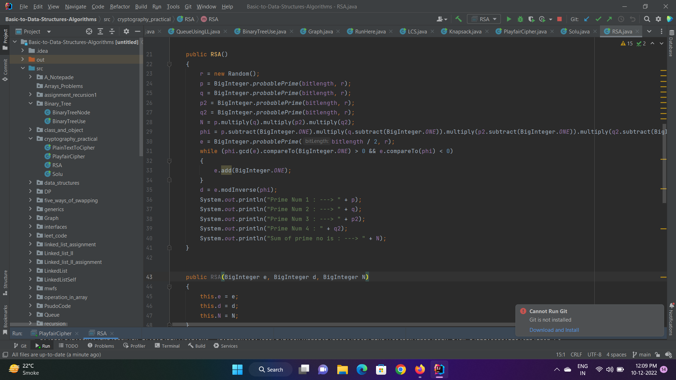
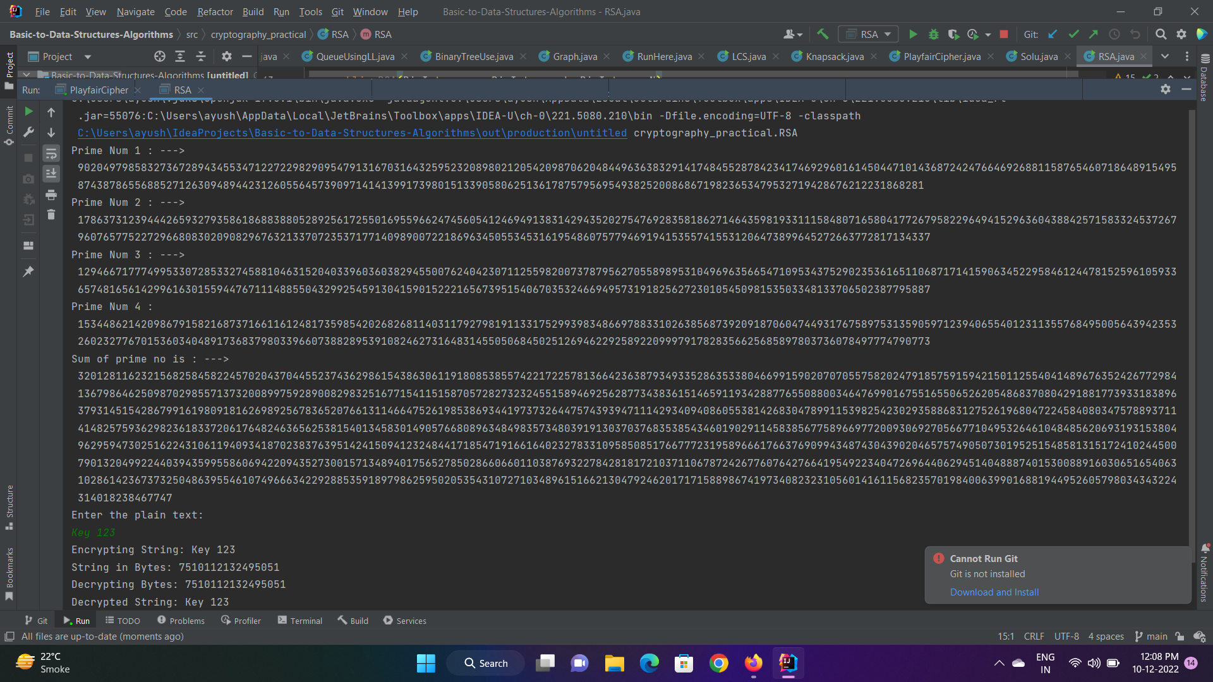
Extended RSA :-

Slide 19

FUTURE SCOPE
As a child, you may have used secret messages or languages to communicate with friends or siblings, and you have likely observed the use of cryptography in various aspects of our society – maintaining the confidentiality of personal, consumer, corporate, and government data. However, on top of this, cryptography’s status as an indispensable building block in digital infrastructure continues to grow with the perpetual increase in online connectivity – securing online transactions, authentication, and access to resources. The Scope of the project is that we can Send our information form one channel to another channel with fully protected manner so that no one can know the our confidential information like id , Passwords , Bank Balance etc This Algorithm can implemented in startups , individuals Growing Business for keep safe their confidential information to Any One who have not enough budget to buy a cyber security system

Slide 20
CONCLUSION
So far encryption technique adopting the concept of PLAYFAIR CIPHER MATRIX of size 5X5 has been programmed for calculating the Cipher text. Finally, we have pointed the merits and demerits of traditional Playfair algorithm. In order to overcome the demerits, we have proposed an extension to traditional Playfair cipher algorithm; which can be used more efficiently even for the Plaintext containing alphanumeric values and special characters. Then a public key encryption system has been designed which provides both confidentiality and authentication, but there are some limitations. Complete mathematical derivation is given to show the exact result at both sender and receiver sides the previous encryption technique is also a part of this system. After completion of the program the strength of the technique has been checked and this encryption technique can also be used for other networks. In this algorithm playfair matrix is used for creating the cipher text and the Extended RSA algorithm is used for providing the More secure channel than The RSA Algorithm

Slide 21

Thanks!

